Slide 1
Commodity Classic 2018
ANAHEIM, CALIFORNIA

Slide 2
Attendance
2018 Commodity classic

Slide 3
Year-to-Year Attendance
New Orleans
Phoenix
San Antonio
Nashville
Kissimmee
Tampa

Slide 4
Year-to-Year Attendance 2010 compared to 2018

Slide 5
First-Time Attendees (Non-Exhibitor)
Anaheim
Phoenix
New Orleans
San Antonio
Kissimmee
Nashville
San Antonio

Slide 6
Farmer Profile
 | 2018 | 2017 | 2016 | 2015 | 2014 | 2013 | 2012
Total Acres | 2,850 | 2,779 | 2,893 | 3,009 | 2,520 | 2,332 | 2,401
Corn Acres | 1,169 | 1,137 | 1,197 | 1,247 | 1,117 | 1,112 | 1,098
Soybean Acres | 1,124 | 1,020 | 1,117 | 1,122 | 862 | 870 | 859
Wheat Acres | 910 | 861 | 992 | 1,247 | 897 | 686 | 844
Sorghum Acres | 474 | 445 | 471 | 467 | 582 | 419 | 670
Cotton Acres | 872 | 1,023 | 988 | NA | NA | NA | NA
Avg. Age | 50.2 | 50.1 | 52.6 | 53.4 | 51.7 | 52.9 | 52.8
Based on registered farmers completing demographic information

Slide 7
Farmer Profile - Continued
 | 2018 | 2017 | 2016 | 2015 | 2014 | 2013 | 2012
No. Feedlot Cattle | 550 | 314 | 604 | NA | NA | NA | NA
Cow/Calf Pairs | 240 | 177 | 150 | NA | NA | NA | NA
Avg. Cattle | NA | NA | NA | 481 | 414 | 446 | 401
Avg. Hogs | 7,500 | 7,956 | 7,994 | 7,363 | 6,511 | 7,280 | 8,642
Hay/Forage Acres | 485 | 432 | NA | NA | NA | NA | NA
Peanut | 893 | 646 | NA | NA | NA | NA | NA
Based on registered farmers completing demographic information

Slide 8
Other Attendee Groups
 | 2018 | 2017 | 2016 | 2015 | 2014 | 2013 | 2012
Media | 152 | 162 | 186 | 148 | 160 | 138 | 156
 | 2018 | 2017 | 2016 | 2015 | 2014 | 2013 | 2012
Youth (15-22) | 165 | 198 | 291 | 188 | 263 | 414 | 270
Child (14 & under) | 340 | 136 | NA | NA | NA | NA | NA
 | 2018 | 2017 | 2016 | 2015 | 2014 | 2013 | 2012
College Students | 116 | 50 | NA | NA | NA | NA | NA
Based on registration categories

Slide 9
Farmer Map
CANADA
MB 33 | ON 177 | NS 4
QC 22 | SK 7
20
4
15
138
279
CT 8
DC 9
DE 23
MA 16
MD 46
NJ 12
VT 1
16
34
34
90
156
101
10
54
281
383
191
2
298
152
2
15
42
35
180
163
105
41
80
66
32
40
28
5
15
46 states & the District of Columbia represented
17
17
29
Nicaragua 1
Japan 1
78
17
17

Slide 10
Trade Show
2018 Commodity classic

Slide 11
Trade Show Profile

Slide 12
Number of Companies by Products and Services
Total Companies = 367

Slide 13
Net Square Feet by Exhibitor Category
Total Net Square Feet = 189,400

Slide 14
Onsite Survey
2018 Commodity classic

Slide 15
Main Reasons for Attending
* ‘other farmers’ was changed from ‘other growers’ in 2018
** ‘row crops’ was changed from ‘crop industries’ in 2017
Q1. What was the main reason you decided to attend Commodity Classic? Q2. What was the second main reason you decided to attend Commodity Classic? Q3 What was the third main reason you decided to attend Commodity Classic?

Slide 16
Education Most Interested In
Q4. What was the main type of education you are most interested in getting at the Commodity Classic? Q5. What was the second type of education you are most interested in getting at the Commodity Classic? Q6. What was the third type of education you are most interested in getting at the Commodity Classic?

Slide 17
Registration Fee
Q7. Were the following Commodity Classic expenses paid for by you (or your farm/business) or paid for in part or in full by someone else such as a supplier or your state association?

Slide 18
Attending If Fees Had Not Been Paid For
Q8. Would you have attended if your [EXPENSE] had not been paid for?

Slide 19
Direct Others in Making Purchase Input Decisions
Q10. Do you direct others in making purchasing input decisions for your farm?

Slide 20
Role in Operation
Q9. Which of the following statements best describes your role on the operation?

Slide 21
Likelihood to Make Decision Based on C.C. Information (Farmers Only)
Q11. For each of the following topics, how likely are you to make production decisions based on information you receive at Commodity Classic?

Slide 22
Farming Phase Demographic
Percent of 2018 Respondents (n=398)
D2. Which of the following best describes your role in the farming operation?

Slide 23
Level of Education
Level of Education
Percent of 2018 Respondents (n=464)
D3. Which of the following best describes your level of education?

Slide 24
Age of Respondents
Mean Age | Median Age
50 | 53
Percent of 2018 Respondents (n=464)
D4. What year were you born?

Slide 25
New Commodity Classic Attendees
No
64%
Percent of 2018 Respondents (n=464)
QS1. Is this your first Commodity Classic?

Slide 26
Attendees Who Consider Themselves Early Adopters
D8. Would you say you are one of the first to adopt new products and practices on your operation when they become available in your area?

Slide 27
Number of Farmers Influenced
Mean | Median
13 | 5
D9. How many farmers in your area would you say often ask your opinion on new agricultural products and practices?

Slide 28
Post-Event Survey
2018 Commodity classic

Slide 29
Convention Registration Process
*Added in 2017
Q4. Please rate your satisfaction with the following:

Slide 30
Monday Opening Welcome Reception
Q4. Please rate your satisfaction with the following:

Slide 31
General Session
*Starting in 2015, no longer including those who say ‘no comment’ in total %
**Survey moved from paper to on-line format
Q4. Please rate your satisfaction with the following:

Slide 32
Evening of Entertainment
*Starting in 2015, no longer including those who say
‘no comment’ in total %
**Survey moved from paper to on-line format
Q4. Please rate your satisfaction with the following:

Slide 33
Commodity Classic Mobile App
*Added in 2015
Q4. Please rate your satisfaction with the following:

Slide 34
Main Stage Education
*Starting in 2015, no longer including those who say ‘no comment’ in total %
**Survey moved from paper to on-line format
Q4. Please rate your satisfaction with the following:

Slide 35
Overall Educational Value
*Starting in 2015, no longer including those who say ‘no comment’ in total %
Q4. Please rate your satisfaction with the following:

Slide 36
Overall Trade Show
*Starting in 2015, no longer including those who say ‘no comment’ in total %
Q4. Please rate your satisfaction with the following:

Slide 37
Location
*Starting in 2015, no longer including those who say ‘no comment’ in total %
Q4. Please rate your satisfaction with the following:

Slide 38
Likelihood of Recommending Commodity Classic to a Friend
Mean
8.6
8.4
8.6
8.4
8.6
*Added in 2014
Q10. How likely are you to recommend attending the Commodity Classic to a friend?

Slide 39
Top Three Reasons for Attending
* ‘Opportunity to meet with farmers from around the country’ added in 2018
* ‘Opportunity to meet with company representatives’ added in 2018
**Meetings changes from Programs in 2017
Q6. Please Rank the Top 3 Reasons for Attending:

Slide 40
Overall Commodity Classic
*Starting in 2015, no longer including those who say ‘no comment’ in total %
Q4. Please rate your satisfaction with the following:

Slide 41
Acres & Dollars Impact
2018 COMMODITY CLASSIC

Slide 42
Methodology
Commodity Classic Registration
Commodity Classic Surveys
USDA NASS January 2018
USDA WASDE March 2018
USDA ERS December 2017

Slide 43
High Impact
7,085,579 total acres in attendance
Corn: 2,252,663
Soybeans: 2,165,948
Wheat: 1,753,570
Sorghum: 913,398
Per Farm
Avg. Gross Farm Income: $1,508,415
Avg. Equipment Purchases: $347,622
Avg. Seed & Chem. Purchases: $297,092
Avg. Fertilizer Purchases: $214,774

Slide 44
High Impact
7,085,579 total acres in attendance
Corn: 2,252,663
Soybeans: 2,165,948
Wheat: 1,753,570
Sorghum: 913,398
Total Gross Farm Income: $2,906,716,033
Equipment Purchases: $669,866,746
Seed & Chem. Purchases: $572,496,496
Fertilizer Purchases: $413,869,151

Slide 45
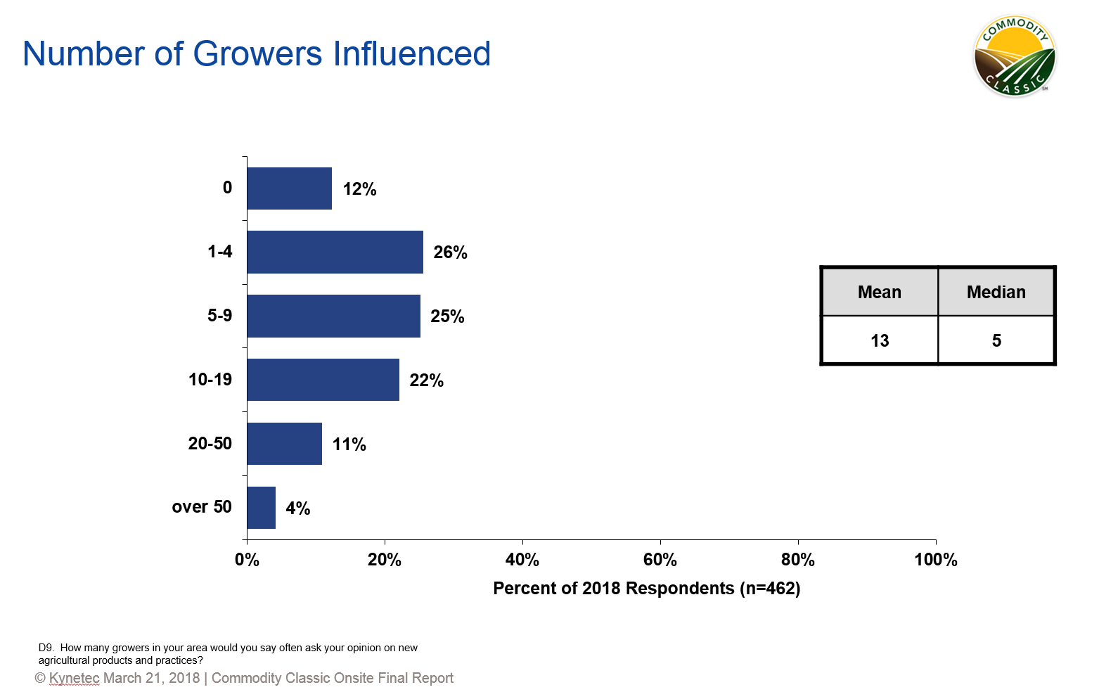
Impact Beyond the Event

Slide 46
High Impact (Factor 5)
35,427,895 total acres impacted (15%)
Corn: 11,263,315
Soybeans: 10,829,740
Wheat: 8,767,850
Sorghum: 4,566,990
Total Gross Farm Income: $14,533,580,163
Equipment Purchases: $3,349,333,731
Seed & Chem. Purchases: $2,862,482,480
Fertilizer Purchases: $2,069,345,756

Slide 47
High Impact (Factor 13)
85,549,760 total acres impacted (37%)
Corn: 28,879,140
Soybeans: 27,767,453
Wheat: 22,480,767
Sorghum: 6,422,400
Total Gross Farm Income: $36,063,260,235
Equipment Purchases: $8,140,909,566
Seed & Chem. Purchases: $7,136,846,226
Fertilizer Purchases: $5,112,549,423

Slide 48
Questions?

